Slide 1
The impact of plastic pollution and how you can make a difference
Daphne Biliouri-Grant
E: daphnegrant2014@btinternet.com

Slide 2
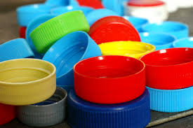
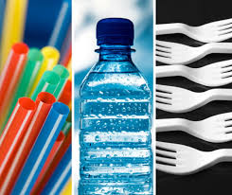
Notes:
Plastic pollution is one of the most urgent environmental issues currently. Following Sir David Attenbourgh’s ‘Blue Planet’ episode on the impact of plastic waste on ocean life, public awareness has increased dramatically since 2018. The main problem being single-use plastics also known as disposable plastics. These types of plastics have a short lifespan ranged from a few seconds to minutes.

Slide 3
Notes:
Plastic was discovered in 1950 and has become a highly valuable resource due to its durability, flexibility and longevity. However, over the years its production line has increased dramatically and the supply of plastic continues to skyrocket. That means that as more plastic is being produced, it has become impossible to dispose of it properly. It is reported that there has been more plastic produced this last decade than the whole of the 20th century.

Slide 4
Notes:
It is amazing to think how long plastic products exist for. With most of them having the ability to survive for hundreds of years, plastic waste is accumulating at a rapid pace in our land and oceans. With demand for plastic expected to continue to rise over the next few years, plastic production will intensify if no alternative resource is identified.

Slide 5
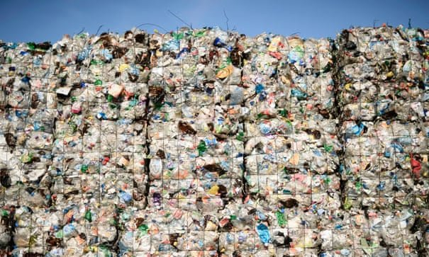
CAUSES OF PLASTIC POLLUTION
OVERPRODUCTION
OVERCONSUMPTION
OVERPOPULATION
Notes:
It is estimated that over 8 billion tonnes of plastic is being used globally with 200 million tonnes of plastic waste in our oceans currently. At this rate, it is projected that plastic production will lead to 34 billion tonnes of plastic by 2050 and inevitably a concerning amount of this will become unsustainable plastic waste.

Slide 6
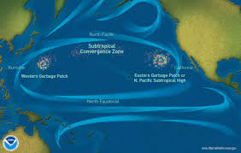
Notes:
There are already areas in our oceans that are covered with plastic waste, the Great Pacific garbage patch being one of the most well-known ones. The patch is actually two enormous masses of plastic waste and floating debris on both sides of the Pacific and it is hundreds of miles long and estimated to be in some areas 5 miles deep.

Slide 7
Notes:
Research on the Great Pacific garbage patch has revealed that the density of the debris varies from area to area and it presents a combination of large pieces of plastic as well as microplastics that have accumulated. The Ocean Cleanup project estimates that the patch contains over 80,000 tonnes of plastic waste.

Slide 8
Notes:
One of the main plastic polluters globally is the fishing industry with discarded fishing nets - also known as ghost nets – representing the biggest pollutant in the world. Ghost nets that have been discarded for years in our oceans pose a big threat as they trap marine wildlife but also by breaking down in microplastics are ingested by marine animals and pollute the water quality of our oceans.

Slide 9
Notes:
The second biggest polluter is the fashion industry as fast fashion over the last decade has led to an incredible amount of waste. The fashion industry is responsible for almost 36% of global plastic pollution and due to its unsustainable methods of production it has an overall negative impact on the environment.

Slide 10
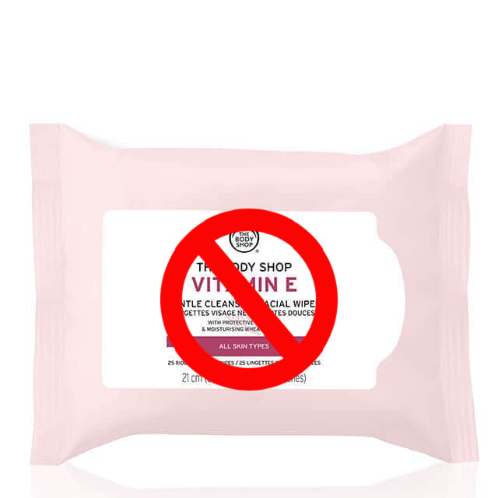
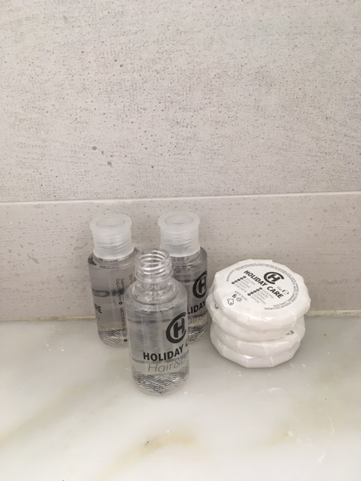
Notes:
So what is the answer? We need to reassess the negative impact that our throw away culture has on the environment. The need of convenience has led to the abundance of single-use plastics that serve no purpose, so we as individuals and consumers need to rethink our priorities and our relationship with our clothes, food and everything that we use on a daily basis. Reduce our consumption patterns, reuse what we already have and refuse new products.

Slide 11
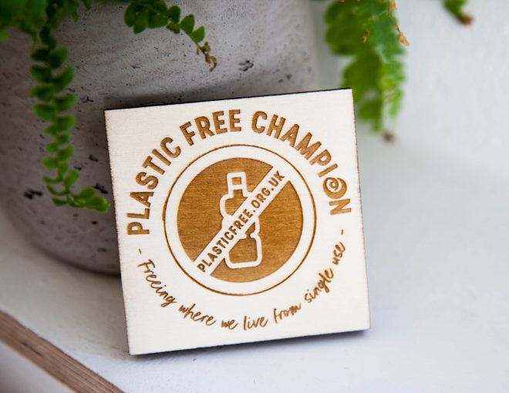
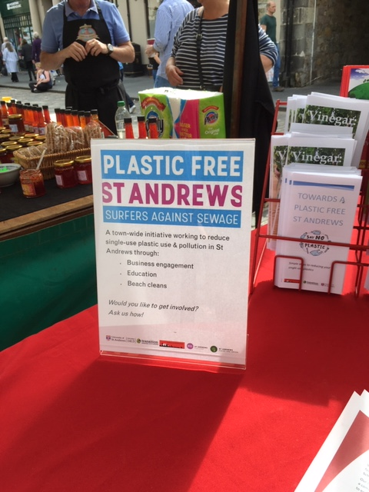
Notes:
I have taken on step further and trying to make a difference by trying to educate people about plastic pollution and try to promote the eradication of single-use plastics. I established and coordinated the Sustainable St. Andrews initiative in 2018 and I was also the Community Leader for St. Andrews on behalf of Surfers Against Sewage and working with the community, main stakeholders, local businesses and the Scottish government to tackle plastic pollution.

Slide 12
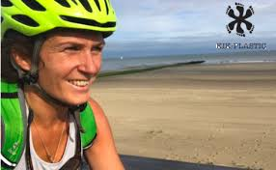
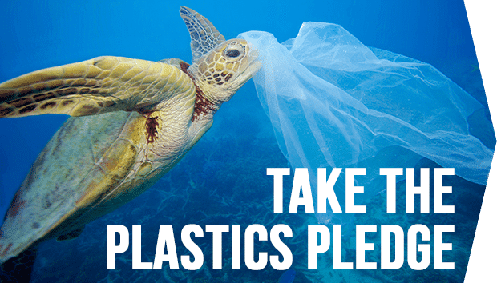
Notes:
I have been bringing people who are keen to get involved and make a difference together and as part of my efforts I am engaging with several environmental NGOs, both on an international and local level. I have been working closely with the local environmental charity, St. Andrews Environmental Network, organised a beach clean here in St. Andrews in July 2019 as part of Kiko Matthews’ national tour of beach cleans to raise awareness on the issue of plastic pollution and ensure that we have regular beach cleans throughout the year.

Slide 13
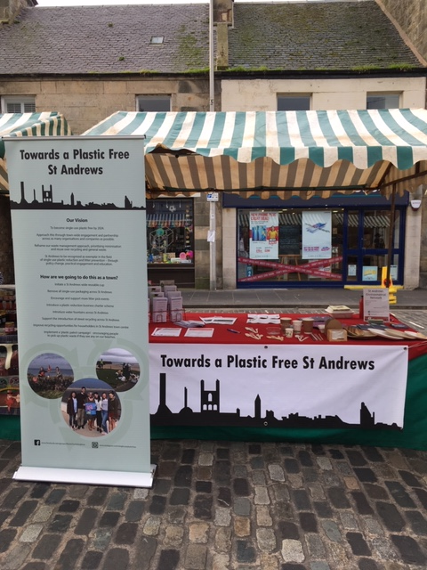
Notes:
We have also come together and launched the initiative with a very successful event at the end of June 2019. I have been giving talks on the subject at schools, the university, local business events and continue to engage with all the main stakeholders. And since the pandemic I have continued to give talks in a variety of audiences but this time virtually.

Slide 14
Notes:
So the question now is what can you do and how you can get involved? At first instance, I would recommend reading one of these brilliant books that gain a better understanding of the enormity of the issue but also they offer some practical ideas of all the things you can do as an individual in your home and workplace to contribute to the eradication of disposable plastics.

Slide 15
Notes:
But most importantly as I mentioned before is about changing our consumption patterns and changing our way of thinking when it comes to our shopping habits. Zero waste shops are becoming the norm so it’s an alternative way of shopping for all your food and household essentials.

Slide 16
Notes:
The other option is to start looking into feasible alternative products to plastic both as an individual consumer as well as a business. There are so many new products that can replace single-use plastics but we still need to be careful that by replacing one for another we are not continue to impact negatively the environment.

Slide 17
Notes:
But the one easy change that everyone can do is swapping disposable coffee cups for a reusable cup. The majority of people buy their teas and coffees on the go nowadays and using a reusable cup can actually make a difference if every single consumer did that. It is estimated that over 12 million cups are used on an annual basis in the UK alone.

Slide 18
Notes:
But the question is also what do the big companies are doing to deal with the issue? Supermarkets have already announced that they will be removing plastic packaging from their fruit and veg aisles and are trying to identify ways to deal with the issue of plastic waste. It is important to note that changing the supply chain is a lengthy and complicated process and on average it will take 12-18 months before we see positive changes in our local supermarkets.

Slide 19
Notes:
On the consumer goods market, there are also several initiatives promoting alternative ways to plastics. Loop is an initiative that has brought over 300 brands together that will provide reusable containers that will be refilled with the branded products as required. This scheme has been operational in the U.S. and France and was introduced to the UK in September 2020.

Slide 20
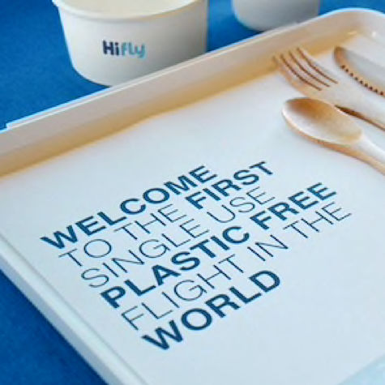
Notes:
Other initiatives has been the establishment of a plastic bottle deposit scheme by supermarket Iceland in its supermarkets, as well as several airlines which are opting to eradicate single-use plastics from all their flights. Several businesses has revisited their production and packaging strategy to implement sustainable solutions.

Slide 21
Notes:
The urgency of trying to control and decrease the use of single-use plastics is undeniable. Therefore, actions need to be taken at all levels and by all stakeholders globally if we are to control the amount of plastic waste that continues to build with every minute that goes by. It’s up to all of us to make a difference and ensure that this doesn’t happen.

